Slide 1

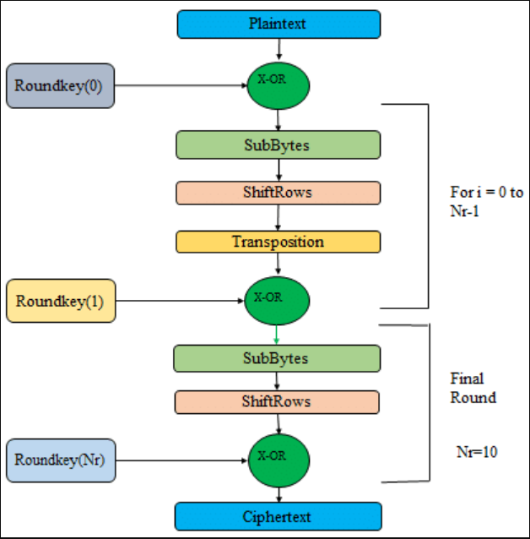
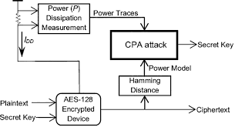

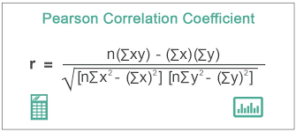
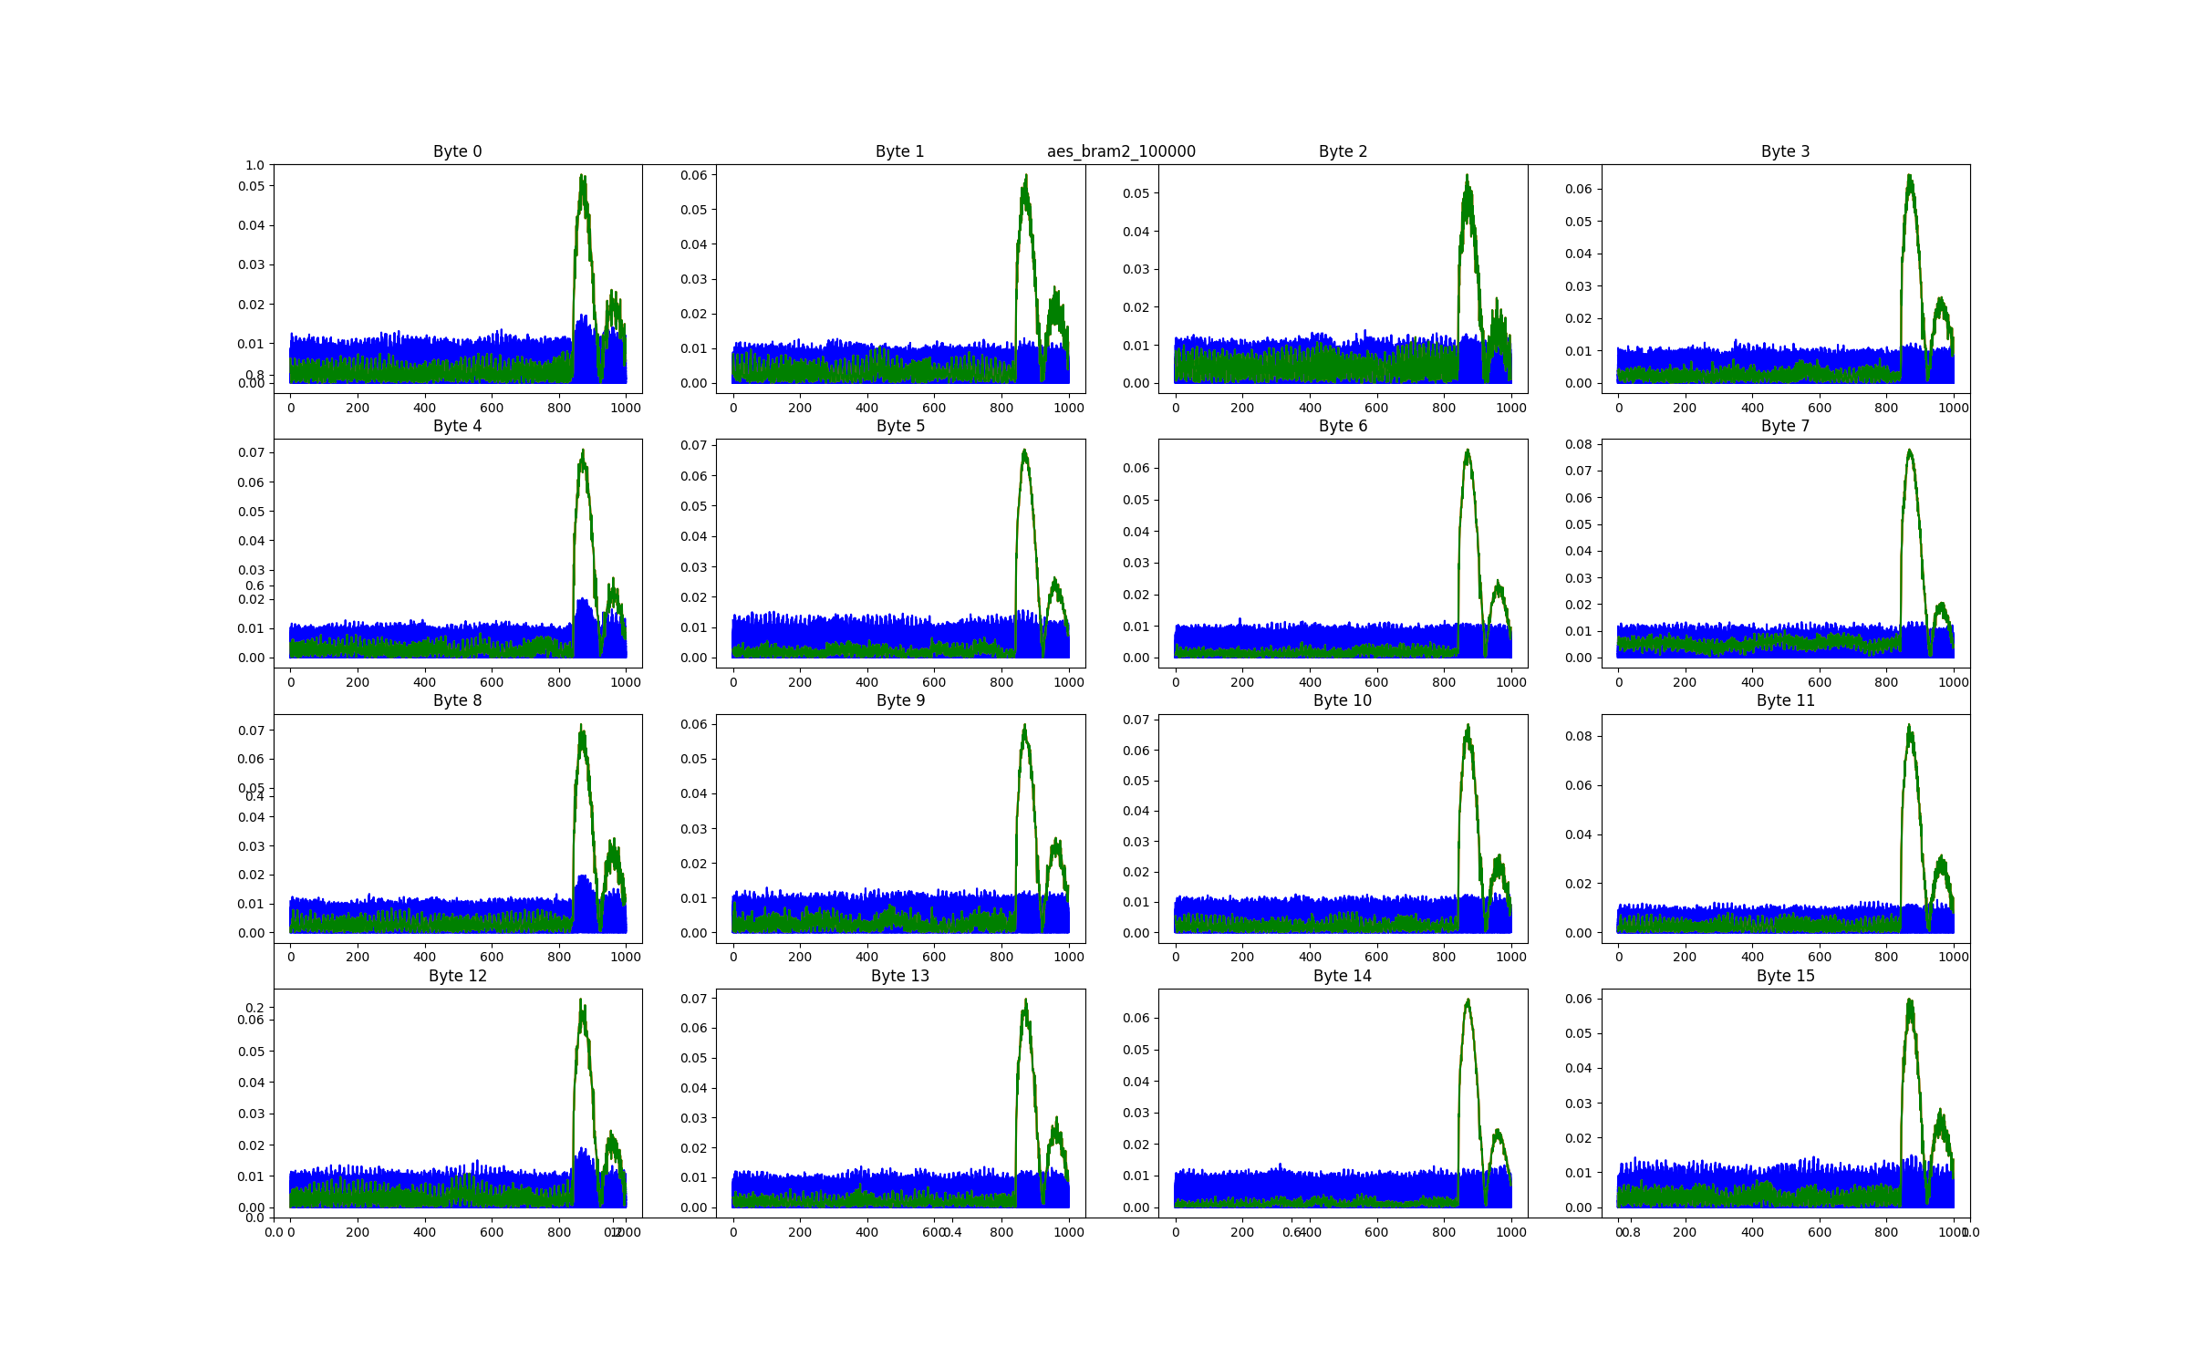

With Great Power Comes Great Leakage!
Platypus: Software Based Power Side Channel Attacks on x86
Himanshu Pandey, Ashish Singh
IIT Kanpur
Platypus: Software Based Power Side Channel Attacks on x86
Non-Cognitive Predictors of Student Success: A Predictive Validity Comparison Between Domestic and International Students
BACKGROUND:
With the Sandy Bridge Microarchitecture, Intel Running Average Power Limit Mechanism was revealed.
Power Domains:
• Package domain: Manages the entire CPU socket.
• Power plane 0 domain (PP0): Charge of all the processor cores on the socket.
• Power plane 1 domain (PP1): Charge of the integrated GPU on the socket.
• DRAM domain. Associated with the DRAM memory.
• Platform domain (PSys). Deals with the whole CPU package, memory, and other devices
AES Algorithm
Key Extraction With CPA
Attack Model:
Mathematical Model:
For extracting Byte 0 of last round, we use:
Pearson Correlation Coefficient :
Results:
Notes:
Notes:
In Powerpoint, click View > Guides
Keep text within gutter guides.
Author list: Don’t split names onto two lines (e.g., “Jimmy [break] Smith”). If that happens, use a new line, unless you need the space. Bold the first names of anybody who’s presenting in person.
Intro/methods/result: Do not drop below font size 28, but if you have extra space, jack up the font size until the space is full.
Do not use color in the sidebars except in graphs/figures. It’ll pull attention from the center and slow interpretation for passersby.

